Slide 1
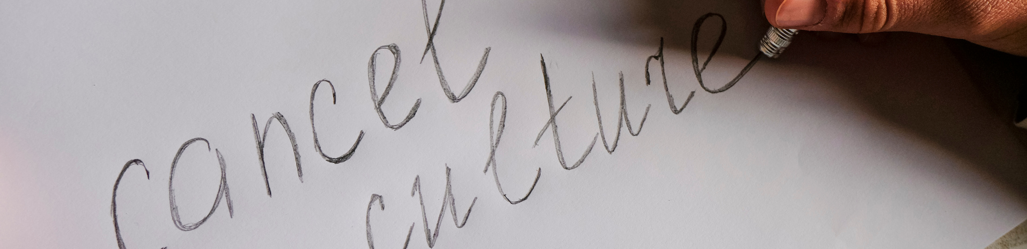
Cancel Culture
Presentation of the Choice of Literature Review Topic and Plan
22227792 HUI HO MAN
01.

Slide 2
Outline
01 - Definition
02 - Reason and purpose
03 - Theme of the literature review
04 - Source text 01: Cancel Culture: A Critical Analysis
05 - Source text 02: No Grand Pronouncements Here...: Reflections on Cancel Culture and sasaDigital Media Participation
06 - Cancel Culture: The Latest Attack on Free Speech and Due Process
07 - Attention Platform 9¾: The Hogwarts Express is Cancelled. Exploration in Cancel asasaCulture, J.K. Rowling, and Beyond
08 - Conclusion
08 - Reference
02

Slide 3
Definition
practice of ostracizing, boycotting, or shunning people deemed to have acted or spoken in an unacceptable manner
expression "cancel culture" came into circulation in the late 2010s and early 2020s and mainly had negative connotations
often used polemically by self-described advocates for free speech and against censorship
02

Slide 4
Reason and purpose
the phrase "cancel culture" is prevalent and hot topic in the political arena these days
many people claim that cancel culture is the reason why
J.K. Rowing being removed in her creations -> huge impact
controversial and has been very much debated over the internet
Therefore -> we need to know what the phrase is about
03

Slide 5
Theme of the literature review
discuss the origin and evolution of cancel culture
review the culture by critically analyzing and synthesizing the collected source text
advantages and disadvantages in different aspects that cancel culture has brought
summarize the culture with real-life incidents -> review the impact caused by the cancel culture
(e.g. J.K. Rowing, Taylor Swift)
04

Slide 6
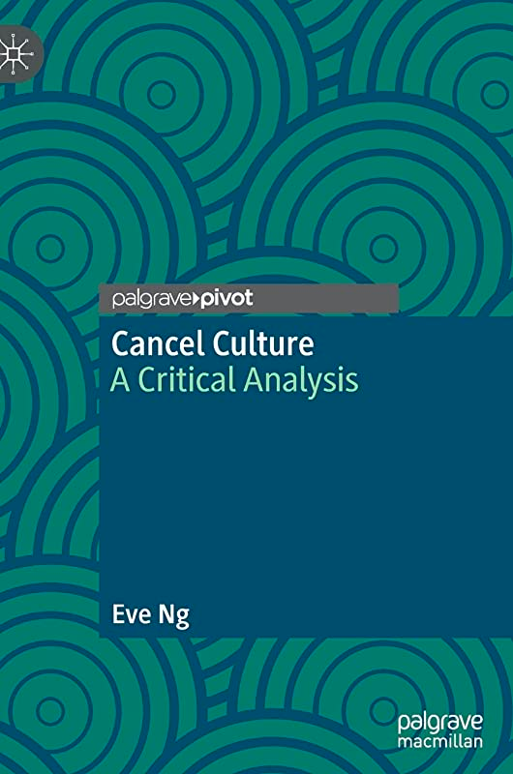
Cancel Culture: A Critical Analysis
By Eve Ng, 2022
provides an analytical framework for theorizing cancel culture
and related phenomena in digital and non-digital spaces
provide helpful insight for me to analyze the pros and cons
of cancel culture
05

Slide 7
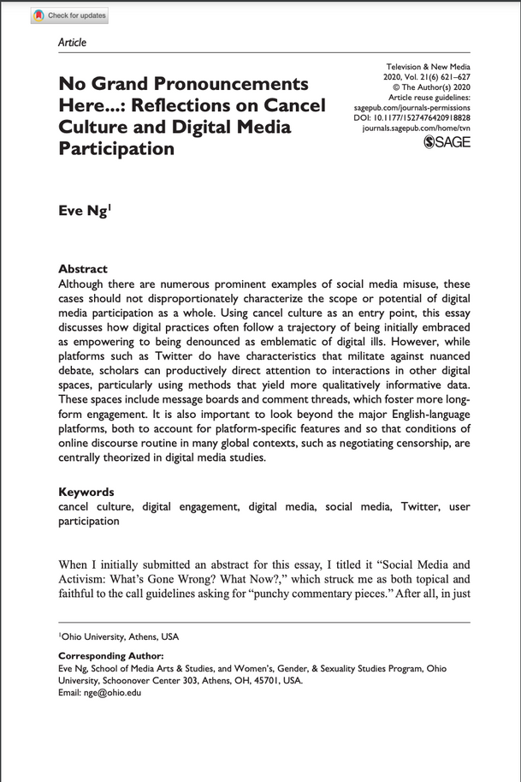
No Grand Pronouncements Here...: Reflections on Cancel Culture and Digital Media Participation
By Eve Ng, 2022
introduces how digital media has become involved in cancel culture
and acting as a catalyst on top of the culture
provide some phenomenon discovered regarding how digital media
and balance culture are related and linked
06

Slide 8
Cancel Culture: The Latest Attack on Free Speech and Due Process
By Alan Dershowitz, 2020
argues for free speech, due process, and restraint against the often overeager impulse to
cancel individuals and institutions altogether at the ever-changing whims of
social media-driven crowds
provide valuable details regarding how cancel culture affected
the freedom of speech and the ethical problem caused
07

Slide 9
Attention Platform 9¾: The Hogwarts Express is Cancelled. Exploration in Cancel Culture, J.K. Rowling, and Beyond
By Mallory Whitson, 2020
indicates that cancel culture within the context of J.K. Rowling represents the worst of what balance culture has to offer
argues that the culture altogether is more harmful than good
provide a real-life example of how to cancel culture had caused
destruction to everything toward personnel
08

Slide 10
Conclusion
Talked about the brief history of cancel culture
the purpose and reason of doing this topic -> newly appear in the society
one of the highly discussed topic around the globe
confused and unexplored topic
worth to do this topic
08

Slide 11
Reference
Cancel Culture. (n.d.). SpringerLink. Retrieved from https://link.springer.com/book/10.1007/978-3-030-97374-2
Dershowitz, A. (2021). Cancel Culture. The Latest Attack on Free Speech and Due Process.
Ng, E. (2020). No Grand Pronouncements Here...: Reflections on Cancel Culture and Digital Media Participation. Television & New Media, 21(6), 621–627. https://doi.org/10.1177/1527476420918828
Whitson, Mallory, "Attention Platform 9¾: The Hogwarts Express is Cancelled. Exploration in Cancel Culture, J.K. Rowling, and Beyond" (2021). Culture journal. 795.
https://scholarlycommons.obu.edu/honors_theses/795
08

